Slide 1
EUROPEAN RURAL UNIVERSITY rural territories, innovation spaces and future for europe The role that small towns can play a pan-european view
Presentation The European Council for the Village and Small Town (ECOVAST)
Dordogne, FRANCE November 2013
Valerie J Carter President ECOVAST

Slide 2
INTRODUCTION
This presentation will cover
ECOVAST and its work in rural areas
The European Policy context
The challenges small towns have faced
BUT real opportunities they have for the future
Conclusions on why small towns across Europe are important – particularly for the rural economy, and cultural and heritage tourism in rural areas

Slide 3
ECOVAST NGO
ECOVAST is an International Non Government Organisation set up in 1984 – 10 national sections
Its remit is to foster the economic, social and cultural vitality and identity of rural communities (villages and small towns) throughout Europe
Its key areas of work are small towns; landscape identification; rural buildings/heritage and rural tourism
We have been working for nearly 30 years to promote small towns and are using this experience to try and influence policy makers in both the Council of Europe and the European Commission
we have prepared a formal Position Paper on ‘The Importance of Small Towns’ (October 2013) to submit
ECOVAST has developed these ideas through discussions on small towns at 27 events in 14 countries

Slide 4
EUROPEAN POLICY CONTEXT
No specific policies exist for small towns
Developing concept of Urban / Rural Networks
research by the International Organisation for Economic Cooperation and Development (OECD) supported by DG Regio and RURBAN network
New 7 year period of EU funding
future multi-funding approach rather than ‘silos’
Council of Europe Guiding Principles for Sustainable Spatial Development of the European Continent include
Improve relationship between town & countryside
Enhance cultural heritage as part of development
Encourage high quality sustainable tourism

Slide 5
RURAL-URBAN PARTNERSHIPS
The settlement patterns across Europe are varied
Not just about urban areas and rural areas
metropolitan areas: large towns: medium sized towns: and small towns
Rural areas are not all the same either
rural areas around metropolises: rural areas outside metropolitan areas: and remote rural areas – mountains and islands
Lots of different linkages between them
BUT linkages are about function & hinterlands not administrative boundaries

Slide 6
RURAL-URBAN PARTNERSHIPS
But it is not a simple pattern
Not every region has a metropolis
The role of a metropolis is not always felt by people living in middle sized or smaller towns
even though they acknowledge its importance
All towns even small ones have hinterlands too
small towns particularly have a hinterland of villages, hamlets and countryside
they attract people into them on a daily basis for employment, shopping, education, and leisure
and are often the hub of local transport
But in turn they are in the hinterland of large towns

Slide 7
RURAL-URBAN PARTNERSHIPS
Patterns of links are influenced by major rail and motorway links which enable places far away to commute
for instance in SE England there are no fast Intercity rail routes and places within the region can take 1.5 or more hours into London even though they are only 80-90 miles away, yet places with Intercity (nearly 200 miles away) can get to London in just over 1 hour
Many regions have no single major city and are multi centred
Some regions have nothing except small towns
So the situation is diverse not simple
Future rural-urban partnerships will have several different models

Slide 8
WHAT IS A SMALL TOWN
There is no formal definition of a town
A town is about function as well as size
There is no formal agreement of what is a ‘small town’ – it varies from state to state
BUT there are
4,580 small towns with populations between 10,000 - 30,000 people across Europe
64% of all towns in Europe
78 million people live in them
AND very many very small towns of less than 10,000 population

Slide 9
WHY FOCUS ON SMALL TOWNS
Small towns are the backbone of the rural areas that surround them
they are a hub of activity for these villages
providing jobs, shops, many services
often the hub of public transport
They and their hinterlands work together
Small towns are also in the hinterland of large towns and in turn major metropolises
They meet the new policy objective & form an ideal link between urban and rural areas – the ‘jam’ in the sandwich

Slide 10
CHALLENGES FOR SMALL TOWNS
Small towns have experienced some major challenges
centralisation of services
out migration of young people
pressures of new development
impact on landscapes
A major economic recession
loss of jobs; loss of retail; loss of services; and declining public purses
that has had an impact on tourism; and will have an impact on long term sustainability of projects

Slide 11
OPPORTUNITIES & EXAMPLES
BUT It is not all doom and gloom
There are many opportunities for small towns to use their considerable assets and resources to improve their economic situation
Many places in rural Europe will be able to use their cultural assets (heritage, traditions and customs) for tourism – particularly small towns
many are already doing this
They demonstrate a diverse architecture & history
These ideas could be replicated by many others
The following slides illustrate the resources that small towns have or are trying to develop and some best practice examples from across Europe

Slide 12
STAKEHOLDERS
These opportunities have been developed by local people from local communities – they feel passionate about their town and want to be involved in its future
some have managed to access European funding
some funding from their own country
Local people have worked together in partnership
Should include young people
can help involve them in keeping their customs alive
It is a bottom up process
BUT it needs the support of local, regional and national governments and agencies and NGO’s too

Slide 13
USING NEW TECHNOLOGIES
Small towns are a good place for business
They are a good place for entrepreneurs and innovative businesses and ways of working
vacant buildings can be converted into new workshops
The Internet allows work from home or based in small towns and villages
Telecottage movement
Availability of broadband in rural areas
Speed of broadband – downloading pictures
this is particularly important to tourism businesses
Internet cafes
Hot spots
Coffee shops

Slide 14
DIRECT CONTRIBUTION TO ECONOMIES
Small towns are a good place for entrepreneurs to develop new business ventures – for all types of business
New start-ups can share premises
They can also share administrative services
Local retail loyalty schemes
Haslemere, Surrey, England winner of national prize

Slide 15
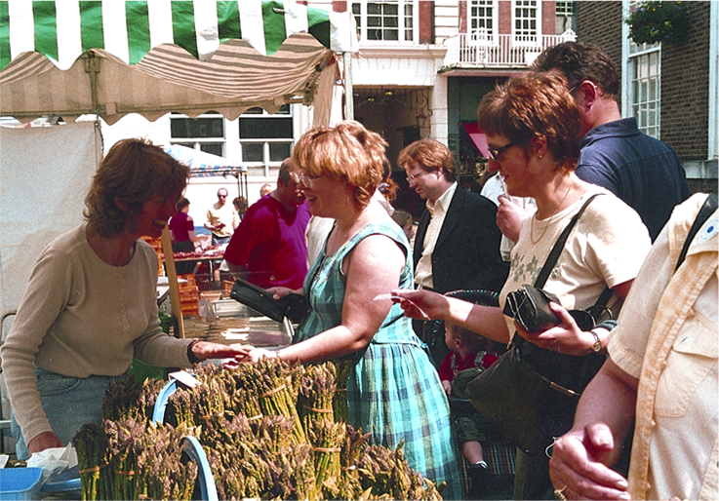
MARKET FOR LOCAL PRODUCTS
Food and drink
Small towns are ideal places to sell local produce from the surrounding rural area
set up ‘Farmers Markets’
Good places to develop food processing businesses
Good quality food and drink is essential for attracting visitors for tourism

Slide 16
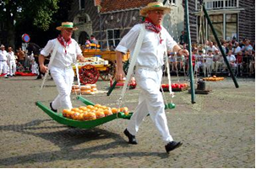
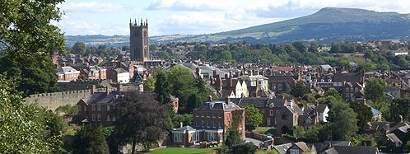
There are specialist ‘food towns’ such as Edam
Towns where good restaurants are their main selling points such as Ludlow

Slide 17
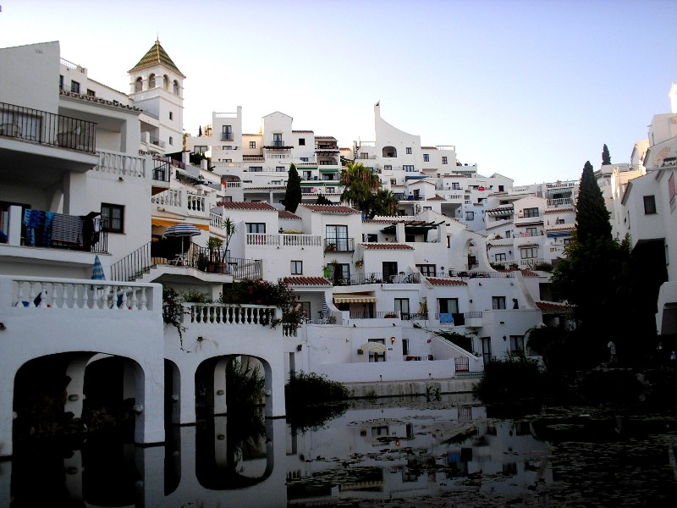
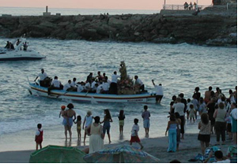
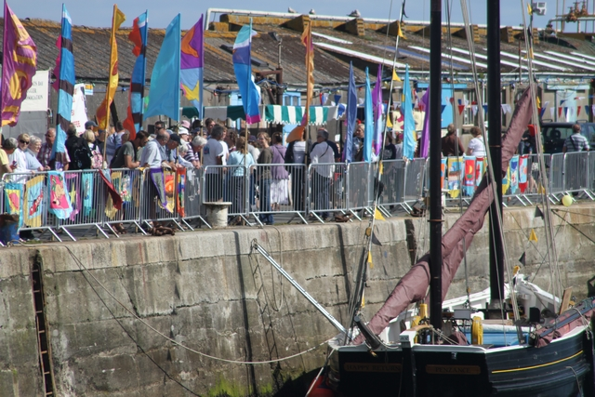
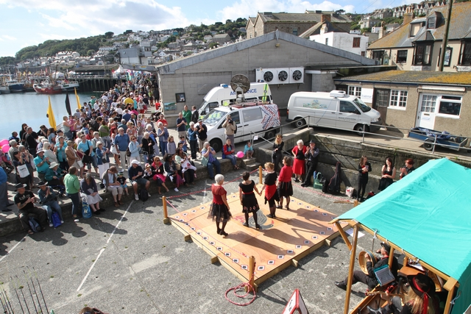
Coastal small towns are often based on fishing and stage fish festivals eg; for example, Nerja, Andalusicia, Spain
and Newlyn in Cornwall, England

Slide 18
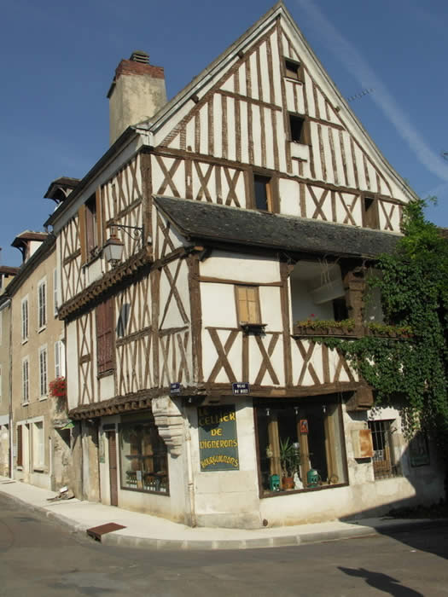
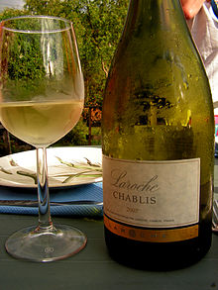
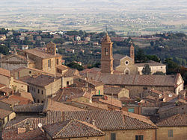
Wine Towns and wine festivals
Europe has hundreds of towns world famous for wine – for example Chablis in France or
Montepulciano in Italy

Slide 19
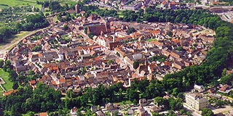
REVITALIZING SMALL TOWN ROLE
Wittstock, Germany wanted to make sure that it was recognised as a ‘town’ not a ‘village’
Small towns provide similar services as large towns but on a smaller scale
Wittstock calls itself a mini-metropole

Slide 20
SHARING SERVICES
Tenterden, England
A vacant shop now houses the town library, post office and drop-in office for the local authority
The town was also able to sell the former library premises

Slide 21
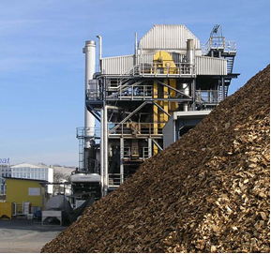
RENEWABLE ENERGY
Gussing in Austria
Wanted to move away from fossil fuels to use fuel crops and local forests
Popular project but it needs further funding which is difficult

Slide 22
USING CULTURE & HERITAGE
The following set of slides are about cultural heritage
We have talked about the potential from local and good food
We have already talked about diversity of local styles reflecting their history
Many have maintained these assets
Small towns are highly distinctive and are attractive to visitors
Many still maintain their local customs
They are involved in lots of different ways to attract visitors into them
Visitors spend money and boost local economies

Slide 23
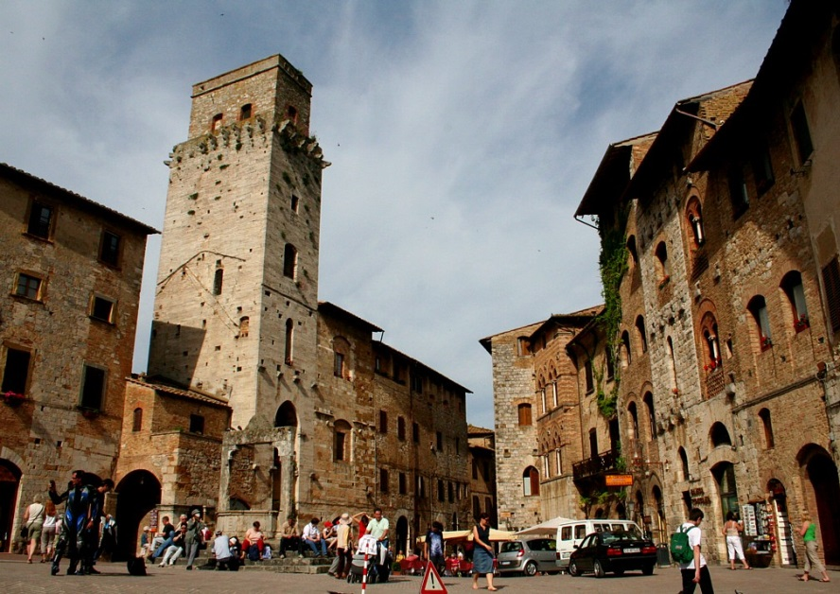
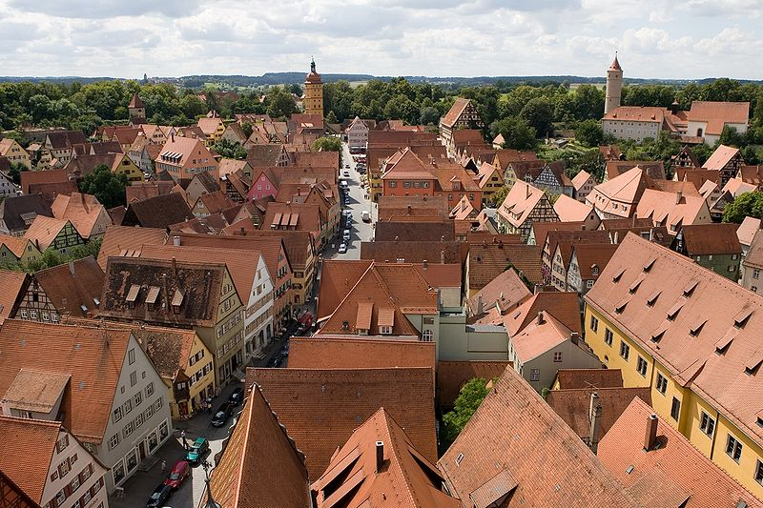
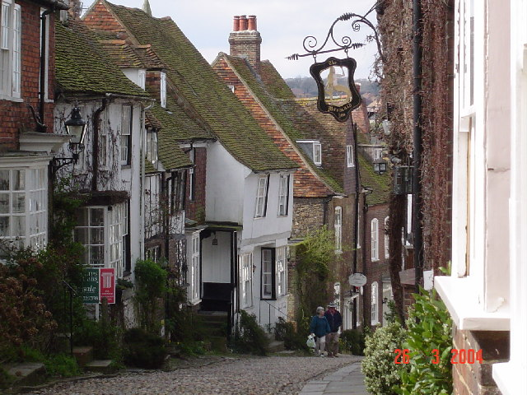
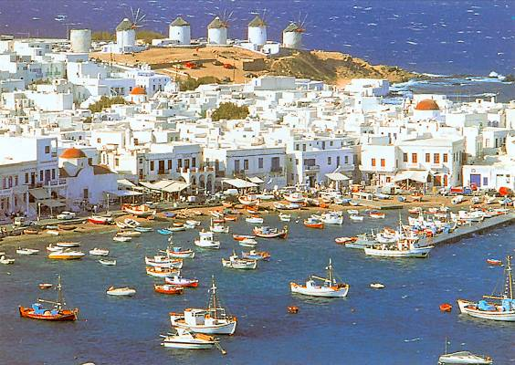

Slide 24
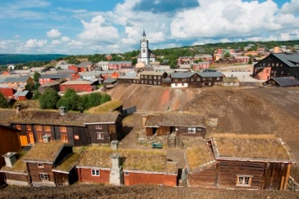
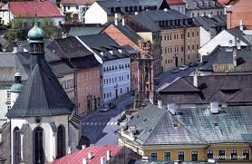
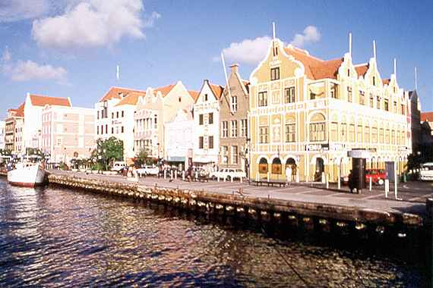
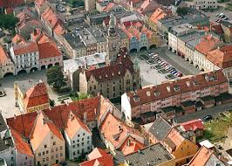
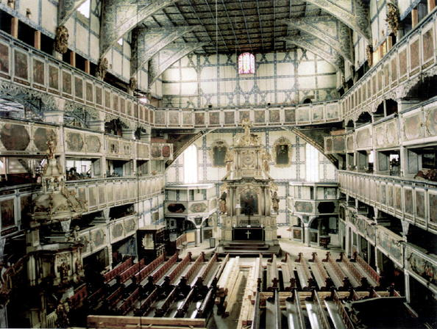
(a) Distinctiveness
Survey of heritage assets which can attract investment
World Heritage List: the whole town such as Banska Stiavnica, Slovakia; Roros in Norway; or Willemstad in the Netherlands or single buildings - the Protestant Peace Church in Jawor, Poland

Slide 25
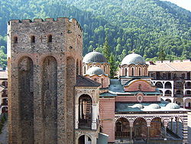
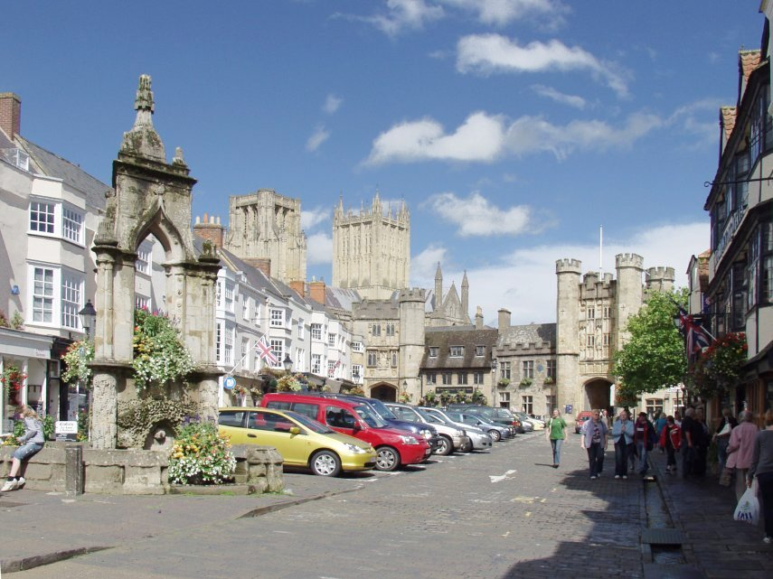
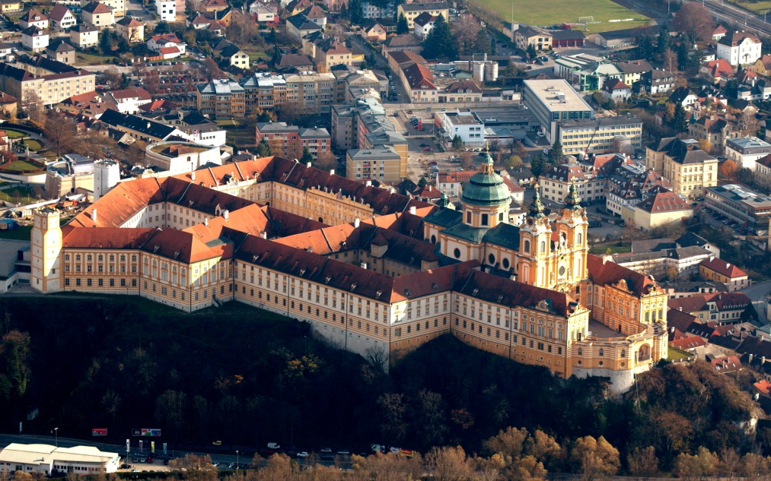
Iconic Architecture
Religion
Monastery towns such or towns with cathedrals
Rila in Bulgaria
Melk in Austria
Wells in England

Slide 26
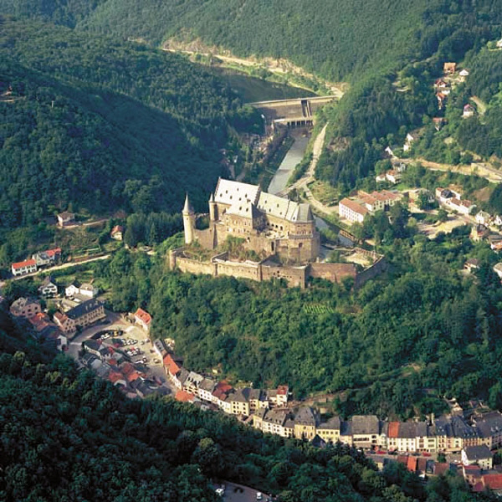
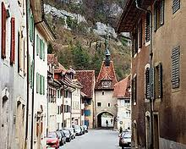
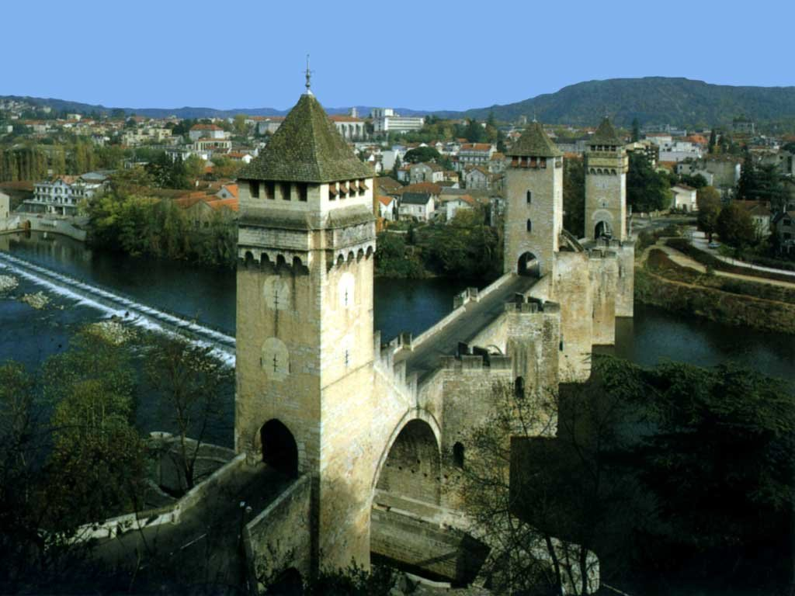
Iconic Architecture
Fortifications
Castle town of Vianden, Luxembourg
Walled town of St Ursanne, Switzerland
Bridge Cahors, France

Slide 27
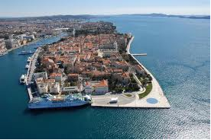
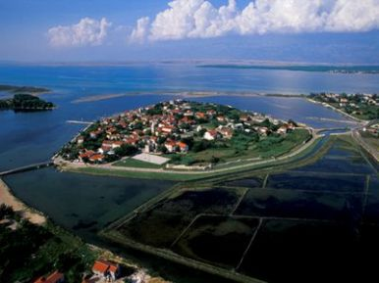
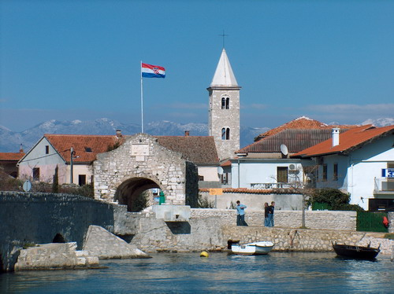
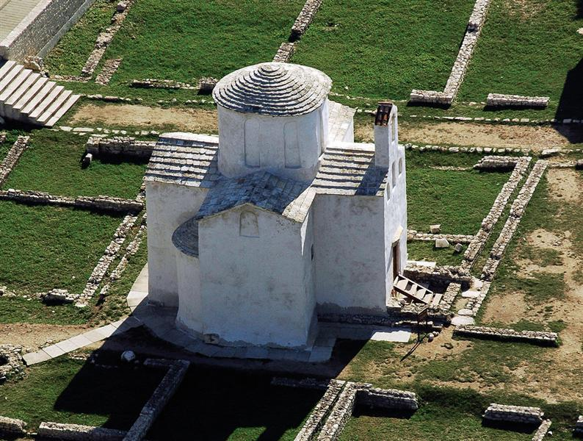
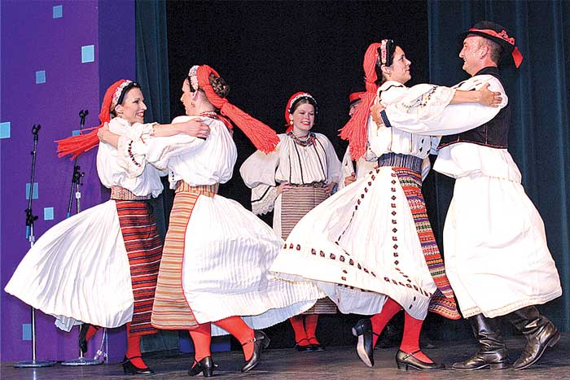
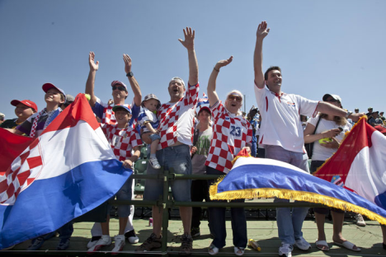
(b) Widening the Choice
Away from the ‘honey pots’ - Island of Nin, Croatia

Slide 28
(c) Festivals, Pageants, Carnivals
Can be aimed at local, regional, national or even international audiences
Staging events can be on a regular annual basis or just for very special events

Slide 29
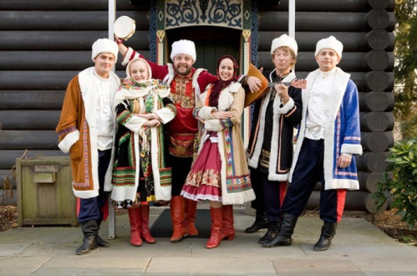
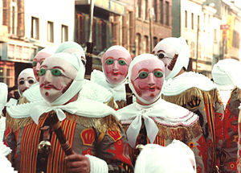
Spring, summer or winter festivals
Russian winter festivals
Binche Spring Festival, Belgium

Slide 30
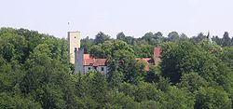
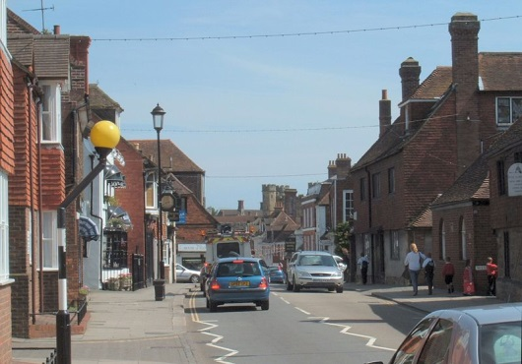
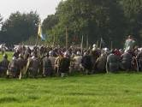
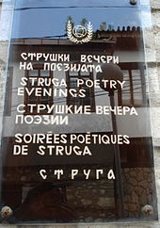
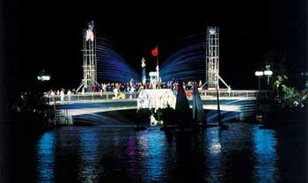
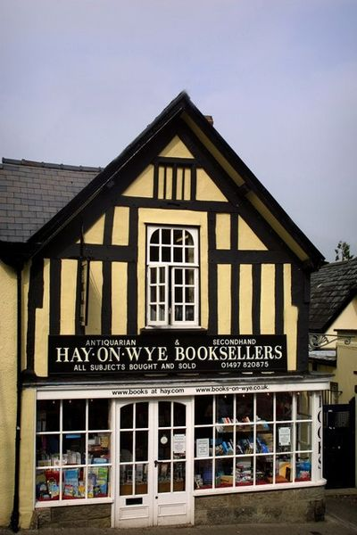
Famous Battles
Grunwald, Germany
Battle, England
Poetry, Book Festivals
Poetry Struga, Macedonia
Hay Book festival, Wales

Slide 31
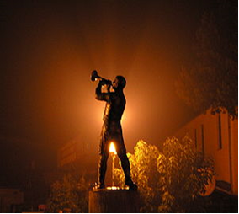
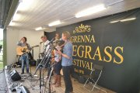
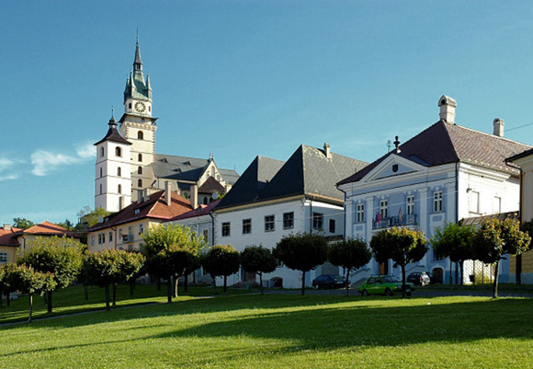
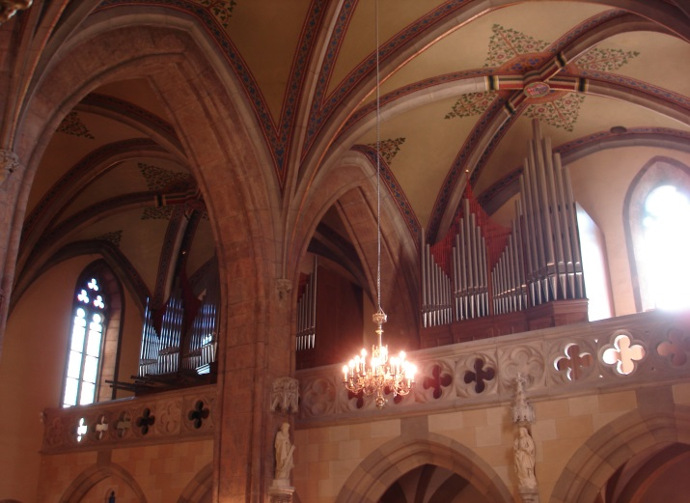
Music festivals
Granna Blue Grass, Sweden
Trumpet Festival Guca, Serbia
Organ Festival Kremnica, Slovakia

Slide 32
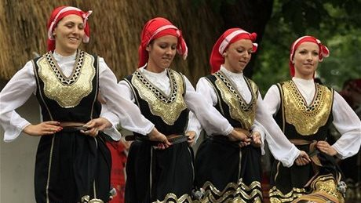
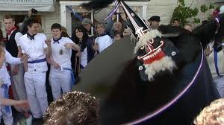
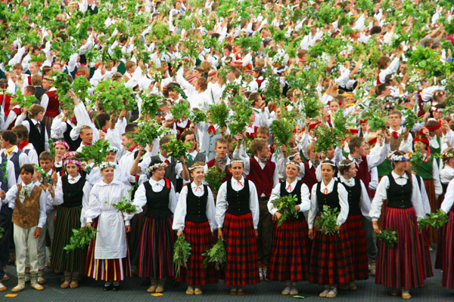
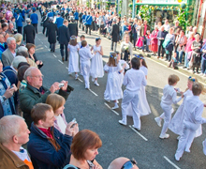
Folklore festivals
Straznice, Czech Republic; & Talsi, Latvia
‘Obby ‘Oss, Padstow & Furry Day, Helston, both festivals in England

Slide 33
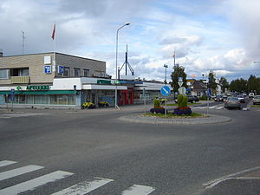
Film festivals
Midnight Sun Film Festival, Sodankyla, Finland

Slide 34
(d) Tourist Trails
The Romantic Road – Germany
Cultural Tourism trail in Romania – Byzantine heritage north of the Danube

Slide 35
(e) Celebrating Local Industries
Many former mining towns are trying to exploit their past as centres for gold, silver, copper, iron ore, slate or mercury mining: Blaenau Ffestiniog, Wales
Idar Oberstein in Germany was a place for mining semi-precious stones and still attracts gem cutters from all over the world to its two gem-cutting schools

Slide 36
(f) Celebrating Famous Local People
Famous authors, composers, even politicians are celebrated in the town of their birth or the place where they lived for a long time
special events can be held on their birth date (or 100 year anniversary)
Famous religious people such as St Francis and St Clare bring in millions of pilgrims into their home town of Assisi in Italy

Slide 37
(g) Niche Markets
Artists, potters and artisans have taken over some small towns
Szentendre in Hungary
The town of Retz in Austria has developed into a major conference town

Slide 38
(h) Sport
Many small towns are involved in Winter Sports – not just the Alps eg Otepaa, Estonia
some have assets which attract both winter and summer visitors - Gstaad in Switzerland

Slide 39
(i) Something Odd
Crop circles have appeared for years around Stonehenge, England
they have attracted many tourists
Farmers in 2013 have guarded their fields and hardly crop circles this year
local hotels and pubs have suffered

Slide 40
MAKING USE OF LANDSCAPE
Small towns are an integral part of the cultural landscape of rural Europe
Many landscapes are recognised as particularly beautiful and designated as National Parks or Regional Parks
Landscapes form a critical part of general ambience of small towns
They are a key attractions for tourism
mountains; hills; coast; lakes; riverside

Slide 41
the countryside & coast also offer a wide range of activities: walking, cycling, riding, canoeing, boating, fishing etc

Slide 42
CONCLUSIONS
Backbone of rural area – thriving small towns contribute to well-being of rural area
They are a place for business and entrepreneurship
Small towns make a significant contribution to local, region and national economies
There are thousands of small towns across Europe
They face many challenges
BUT have many opportunities and where local people who live in them feel passionate about their future
this passion will make them get involved and empowers them to do something about the town
Small towns are distinctive & demonstrate their history and architecture over the centuries

Slide 43
CONCLUSIONS 2
They have maintained culture and local customs
The landscapes they are set in are part of their character
All these small town assets are a major part of the cultural heritage of Europe
They are part of the economic resource of a local area, region and nation
They need to be recognised for their potential
They need to be supported
by policies and funding
They have major assets which can be used to exploit rural tourism

